Slide 1
Chapter 7

Slide 2
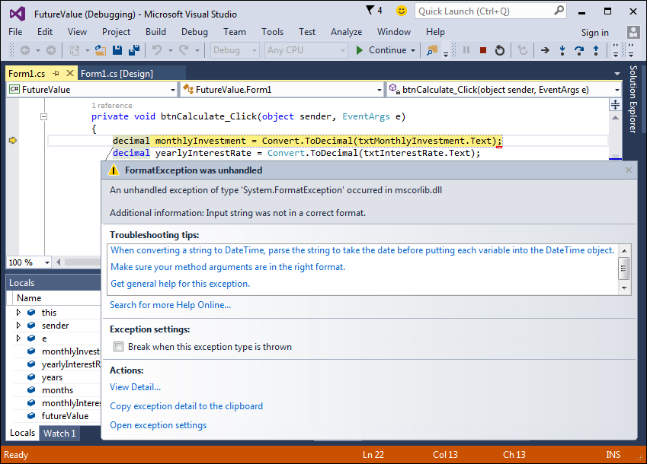
The dialog box for an unhandled exception

Slide 3
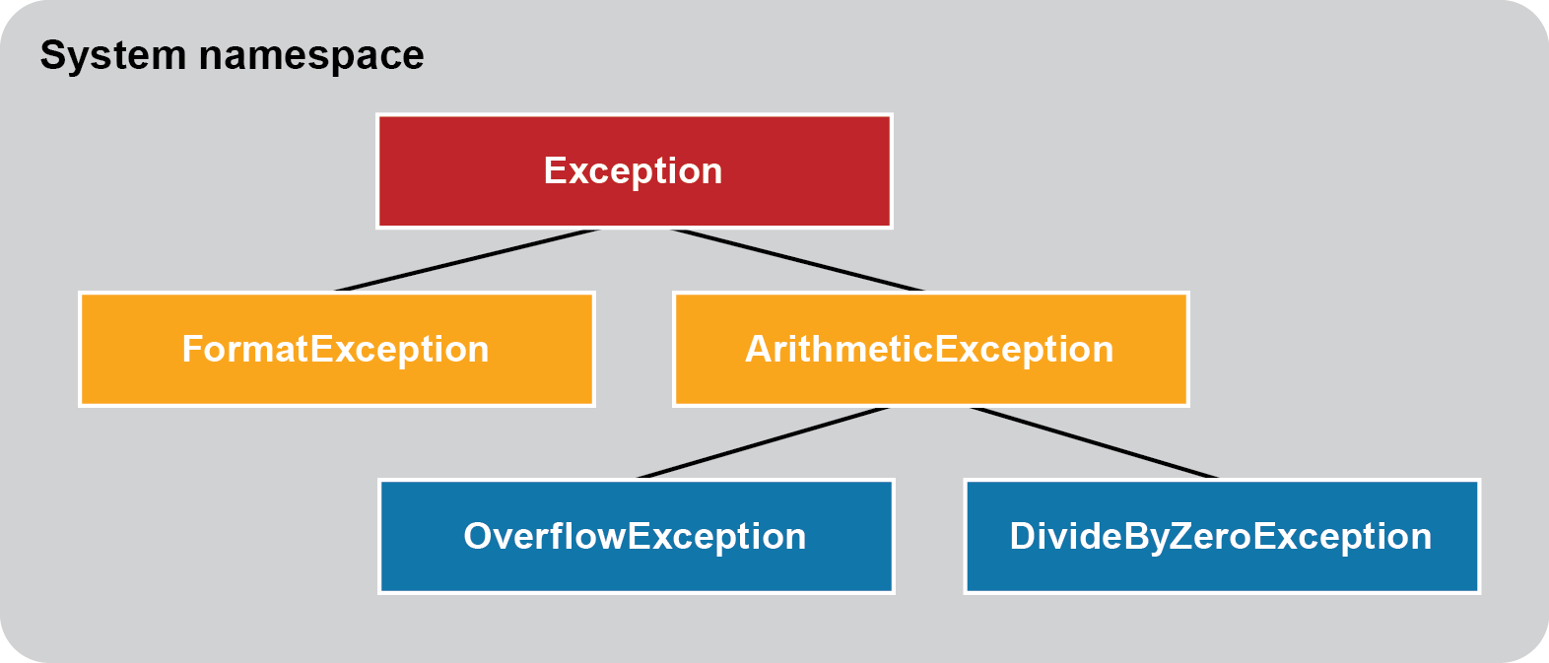
The Exception hierarchy for five common exceptions
Value of one data type can’t be converted to another data type.
Arithmetic, casting, or conversion error.
Result is too large for the receiving variable.
Application is attempting to divide by zero.
All exceptions are subclasses of the Exception class.

Slide 4
Methods that might throw exceptions
In a database: setting a number field to integer instead of long integer.

Slide 5
The syntax to display a dialog box with an OK button

Slide 6
The syntax for a simple try-catch statement

Slide 7
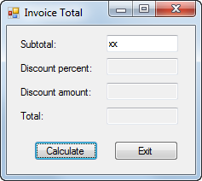
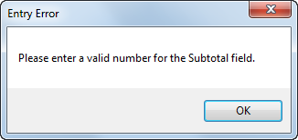
The dialog box that’s displayed for an exception

Slide 8
The syntax for a try-catch statement that accesses the exception

Slide 9
A try-catch statement that accesses an exception

Slide 10
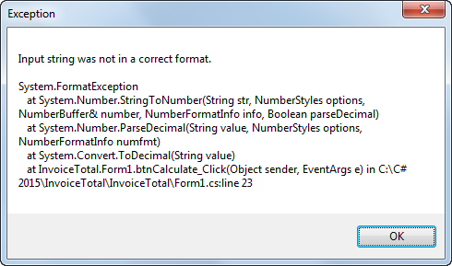
The dialog box that’s displayed for an exception

Slide 11
To Do: Exercise 7-1 and 7-2
To complete these, submit your zipped solution files by 5:00 p.m. on Monday, March 15.

Slide 12
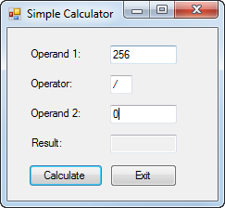
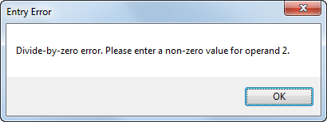
Extra 7-1 Add exception handling to the simple calculator

Slide 13
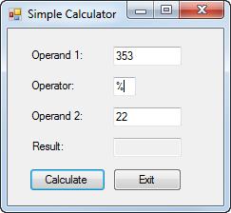
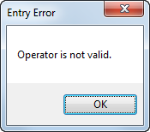
Extra 7-2 Add data validation to the simple calculator

Slide 14
The syntax for a try-catch statement that catches specific types of exceptions

Slide 15
A statement that catches two specific exceptions

Slide 16
The syntax for throwing a new exception

Slide 17
A method that throws an exception when an exceptional condition occurs

Slide 18
Code that throws an exception for testing

Slide 19
Code that rethrows an exception

Slide 20
Code that checks that an entry has been made

Slide 21
Code that checks an entry for a valid range

Slide 22
A method that checks for a required field

Slide 23
A method that checks for a valid numeric format

Slide 24
A method that checks for a valid numeric range

Slide 25
Code that checks the validity of one entry

Slide 26
Code that uses a series of simple if statements

Slide 27
Compound conditions in a single return statement

Slide 28
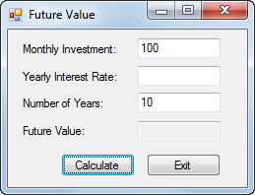
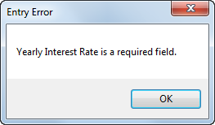
The Future Value form with a dialog box for required fields

Slide 29
The dialog box for invalid decimals

Slide 30
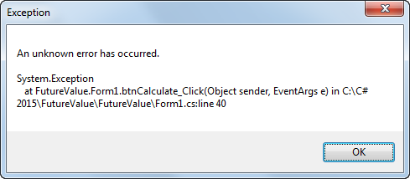
The dialog box for an unanticipated exception

